Slide 1
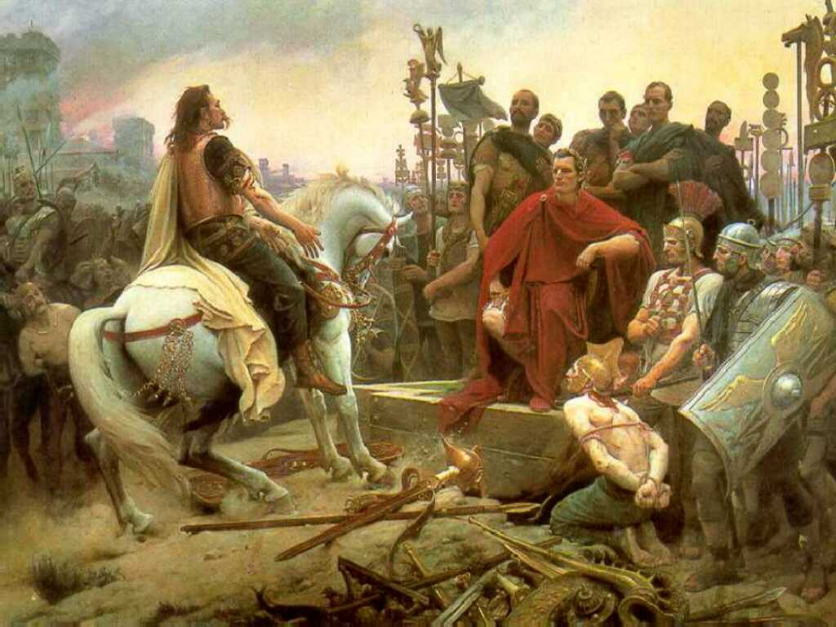
SSWH3 The student will examine the political, philosophical, and cultural interaction of Classical Mediterranean societies from 700 BCE to 400 CE.

Slide 2
a. Compare the origins and structure of the Greek polis, the Roman Republic, and the Roman Empire.
The Greek polis was a city-state,
They varied in form of government: monarchies, aristocracies, oligarchies, democracies, and military states
City-States were usually easy to control, but had many rivals to contend with

Slide 3
Roman Republic (509 B.C.-44 B.C.)
Built on the Tiber River near the Mediterranean Sea
Formed a republic with 2 main ruling groups: the patricians and the plebeians (509 B.C.)
Established written laws (12 Tables)
Had 2 consuls (king like rulers) and a senate
The Army played a large role in the Republic
All adult male landowners were given citizenship

Slide 4
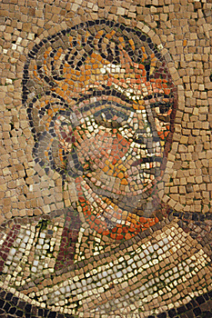
Roman Empire (44 B.C.- A.D. 476)
The Republic began to fail due to economic strains between the classes
After years of civil war, Julius Caesar, a military leader, gained control
Rome was controlled by an emperor and a senate limited in power, and established a civil service

Slide 5
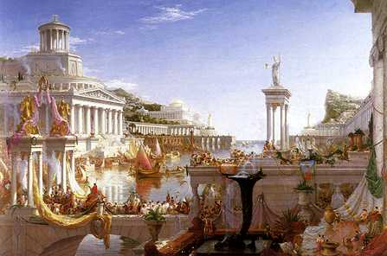
b. Identify the ideas and impact of important individuals; include Socrates, Plato, and Aristotle and describe the diffusion of Greek culture by Aristotle’s pupil Alexander the Great and the impact of Julius and Augustus Caesar

Slide 6
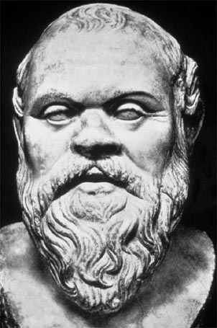
Socrates (469 BC)
The first great Greek philosopher
Wanted people to think about their values and actions
Plato was one of his students
Was sentenced to death for corrupting his students with his ideas

Slide 7
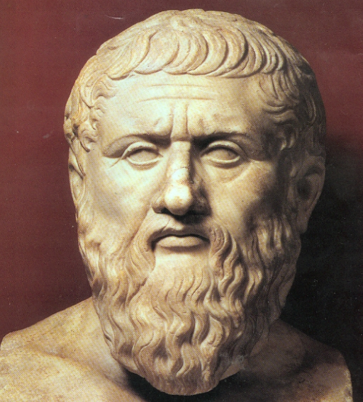
Plato (429 BC)
A Greek student of Socrates
Wrote of a perfectly governed society: Only the elite would vote for what was best for all of the people
Started the Academy-a philosophy school in Athens

Slide 8
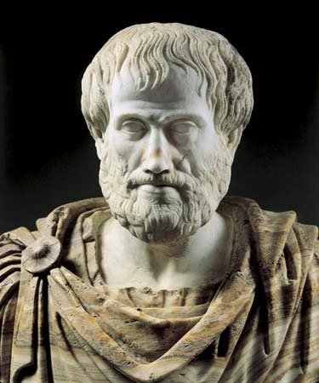
Aristotle (384 BC)
A student at Plato’s Academy
Developed “rules” of logic (scientific method)
Classified governments: monarchies, democracies, republics
Taught Alexander

Slide 9
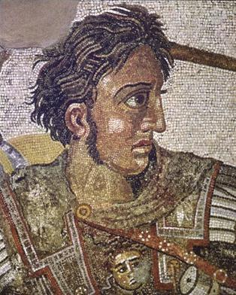
Alexander the Great (356 BC)
Student of Aristotle: Prince of Macedon (upper Greece)
Conquered Egypt and Persia
Promoted religious and cultural freedom in the lands he conquered
Assimilated Greeks into the Persian and Egyptian cultures (Hellenistic)
Died at the age of 33

Slide 10
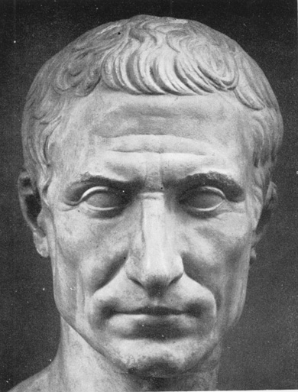
Julius Caesar (100 BC)
Came to power as a Roman military leader
Was named dictator for life
Expanded citizenship to a wide group of people, expanded the Senate, and provided jobs through public works
Set up the Julian Calendar
Caesar was assassinated by Roman senators who had grown jealous of his popularity and power

Slide 11
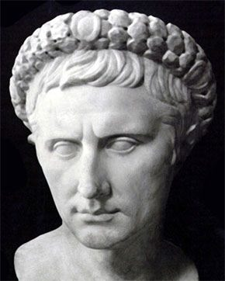
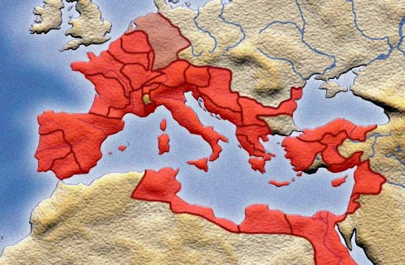
Augustus Caesar (63 BC)
Came to power after Caesar’s death
Ruled over a vast empire
Created a civil service system where common people were paid to help manage the government
Augustus’ reign ushered in the 200 year height of Roman power and influence called the Pax Romana.

Slide 12
c. Analyze the contributions of Hellenistic and Roman culture; include law, gender, and science.
Hellenistic:
-Science:
Studied astronomy and built an observatory
Studied the planets and the sun
Euclidean Geometry
-Culture:
Opened up trade throughout the Mediterranean
Built a research library, art galleries, and a zoo

Slide 13
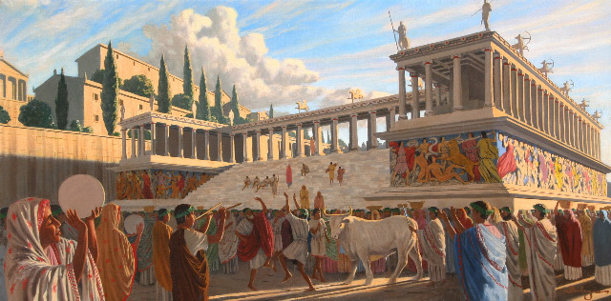
Hellenistic
Law:
-Democracy gave way to a monarchy
-Ended city-states
Gender:
-Women were able to own property
-Women were able to attend school

Slide 14
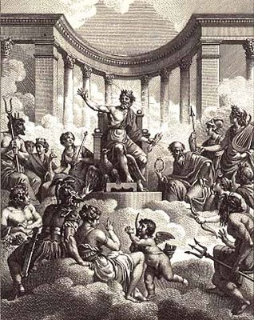
d. Describe polytheism in the Greek and Roman world and the origins and diffusion of Christianity in the Roman world.
The Greeks and Romans practiced polytheistic religions with numerous gods and goddesses whose origins were established through traditional stories of mythology.

Slide 15
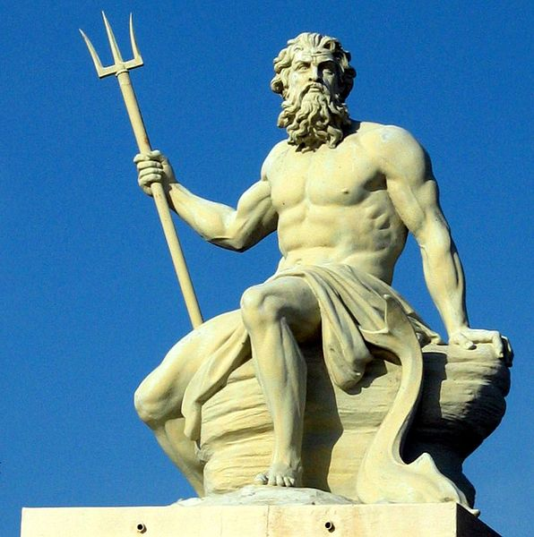
Polytheism in the Greek and Roman world
The Greeks and Romans shared many of the same religious concepts –including the personification of deities. Deities typically had power over specific areas of the natural or social world- for example, god of war, god of love, god of wisdom, god of the sea, etc

Slide 16
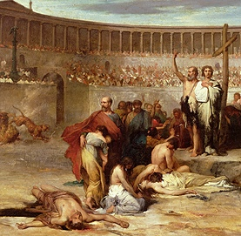
Christianity in the Roman world
Christianity came from the teachings of Jesus of Nazareth and his followers, who believed he was the Messiah prophesized as the savior of the Hebrew (Judaic) peoples. After being persecuted in Rome through the early years, Christianity gradually came to be accepted, then spread throughout the Roman world.

Slide 17
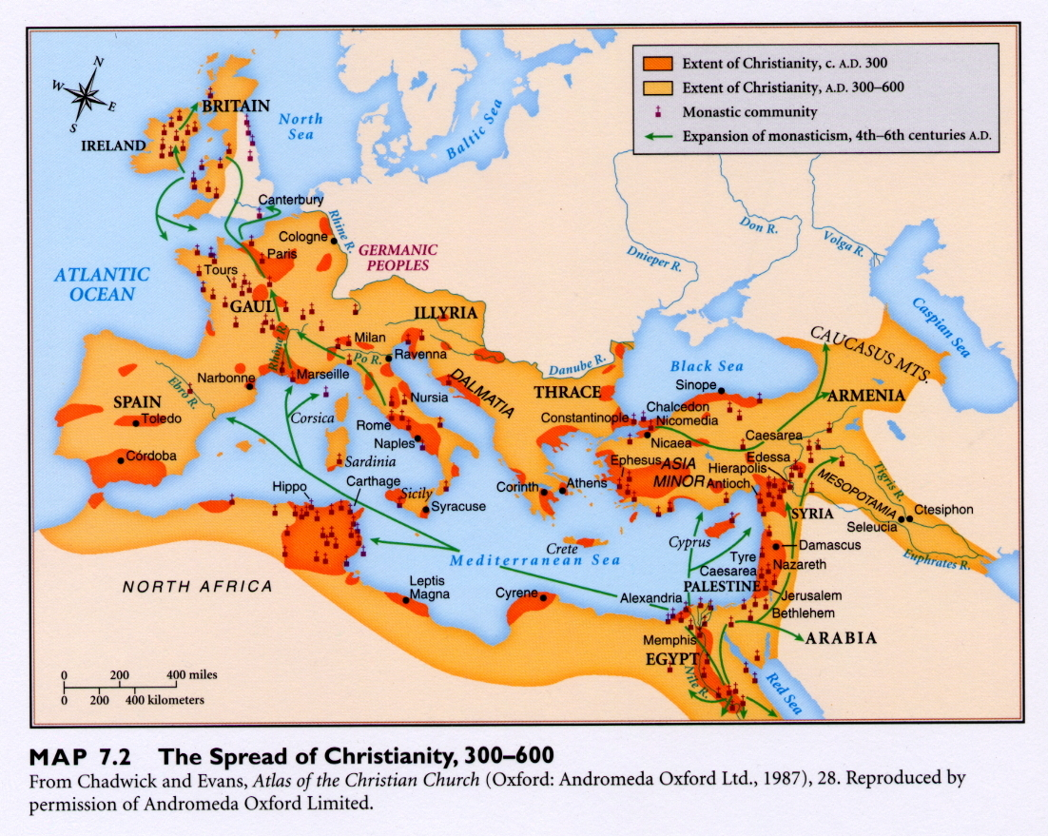

Slide 18
e. Analyze the factors that led to the collapse of the Western Roman Empire.
Political: Empire divided in two parts
Civil War
Social: Lack of interest in government by
people
Contrast between rich and poor

Slide 19
Collapse of the Western Roman Empire
Economic: Poor Harvests
Disruption of Trade by invaders
Military: Threat from Northern Invaders
Recruitment of non-Roman
soldiers developed a lack of loyalty

